Slide 1
My Notes
E-DIARY
Presented By:
Sanya Dilshad, Savya Sharma, Saniya Singla
Under the Mentorship of:
Dr. Himanshi Babbar

Slide 2
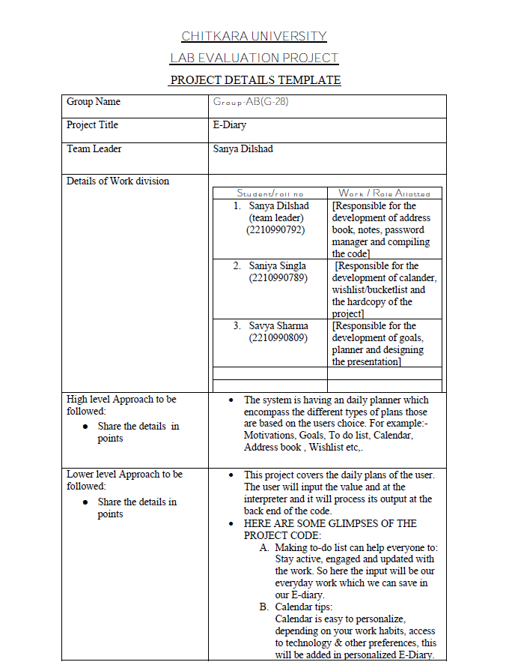
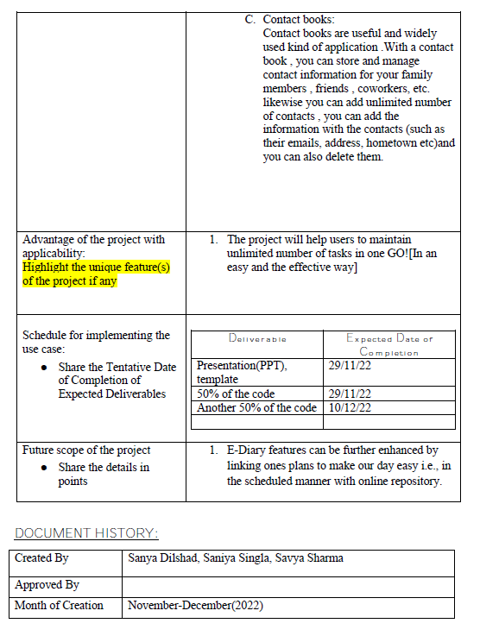
Here goes your title.
08/23/2020

Slide 3
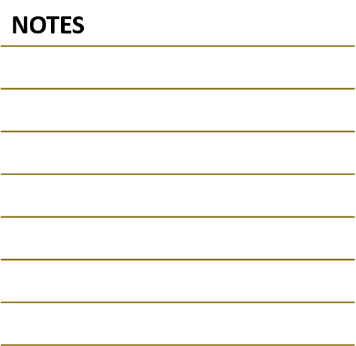
WHY E-DIARY?
NOVEMBER 29, 2022
NOVEMBER 29,2022
We live in a technology driven society where digital devices allow us to multi-task at lightning speed and “too busy” is an all too common catch-cry. Diaries and Planners have the unique ability to slow us down a little, allowing us to function more efficiently and effectively, improving our well-being in the long run.
The electronic dairies offer a range of advantages compared to the paper version of diaries. With the use of technologically advanced devices in various fields, the uses of electronic dairies have also grown simultaneously. These diaries appear quite different from the traditional paper diaries but function in a similar way.
Note to myself:
KEEPING A DIARY IS LIKE A LOOK TO YOURSELF :)
-PAUL CLAUDEL

Slide 4
CONTENTS!!
CALENDAR
ADDRESS BOOK
PLANNER
PASSWORD MANAGER
LET YOUR DREAMS BE BIGGER THAN YOUR FEARS :)

Slide 5
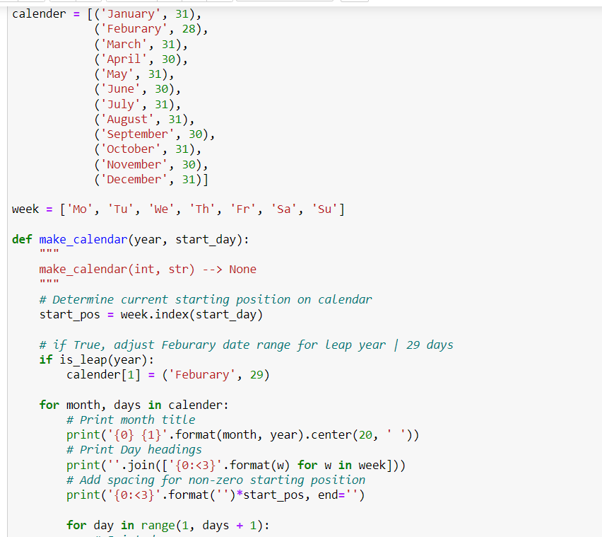
CALENDAR
EVERY ENDING IS A NEW BEGINNING
Calendar is a tabular register of days according to a system usually covering one year and referring the days of each month to the days of the week
Advantages and disadvantages: •Having an E-Diary means no flicking through the pages looking past the scribbles and the unreadable handwriting to find a spare space to jot down stuff or to check what's next •Having a digital calendar means it will send notifications on your smartphone so you can be confident that nothing is ever forgotten and no appointment is missed. •Having a digital diary has only one disadvantage i.e. you should have your device charged up with you almost all time!

Slide 6
WHAT ALL IS USED IN THE CODE? (CALENDAR)
/ quote: EVERY ACCOMPLISHMENT STARTS WITH THE DECISION TO TRY ☺ ^_^☺
NESTED LOOPS
A nested loop is a loop inside a loop.
The "inner loop" will be executed one time for each iteration of the "outer loop"
adj =("red", "big", "tasty“) fruits =("apple", "banana", "cherry“)
for x in adj: for y in fruits: print(x, y)
FUNCTIONS
A function is a block of code which only runs when it is called.
We can pass data known as parameters into a function
A function can return data as a result
A function is defined using def keyword
Example:
def my_function(): print("Hello using a function")

Slide 7
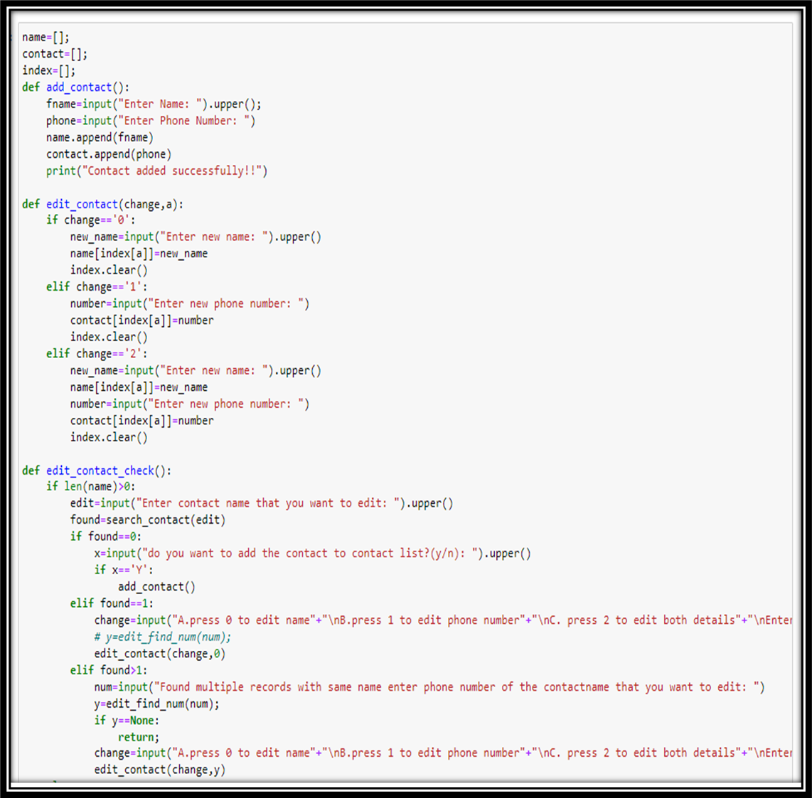
ADDRESS BOOK
-
A contact list shows screen names which could be actual names or aliases for real people. The window with the contact list allows for communication or a similar action upon selecting the name.
ADVANTAGES & DISADVANTAGES OF ADDRESS BOOK
An online address book allows you to manage your address book and get in contact with your contacts while you’re connected to the internet.
An online address book is very beneficial if you lose your phone or your computer breaks, you’ll still have your contact address list. You’ll never need to worry about losing important contact information again.
Although the flexibility of online address book is usually seen as a big plus, their dependence on internet access, different apps and expensive electronic devices can pose a problem

Slide 8
WHAT ALL IS USED IN THE
CODE (ADDRESS BOOK)
OTHERS
Upper() : returns a string where all characters are in upper case where symbols and numbers are ignored
append() : it appends or adds an element to the end of the list where element can be a string, number, object
clear() : removes all the elements from a list
Len() : returns number of items in an object. When the object is a string, the len() function returns the number of characters in the string
LISTS
Lists are used to store multiple items in a single variable
Lists items are ordered, changeable and allow duplicate values
List items are indexed, the first item has index [0], the second item has index [1] etc
Lists are created using square brackets []
Example:
mylist=[“apple”, “banana”, “cherry”]
print(mylist)

Slide 9
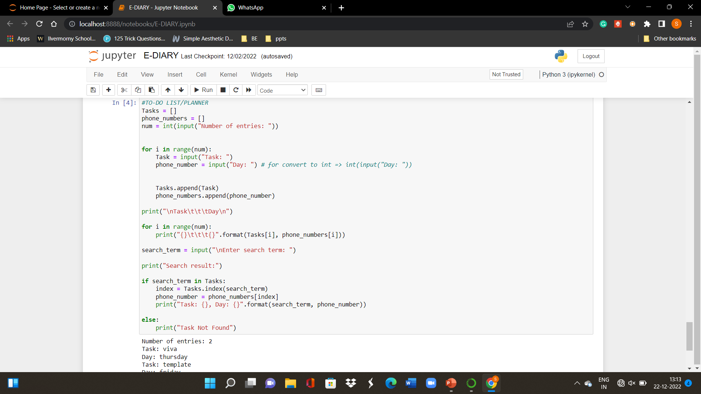
PLANNER
A planner is a small book or binder that is designed to be portable and can be a datebook, date log, daybook, day dated planner, personal analog assistant, book planner, year planner, or agenda Advantages and Disadvantages •One can edit as per their need and it can be synced to all the devices and accessed anytime anywhere •It’s easier to set reminders on them •There are various types of planners and can used as per the requirement. For example: Work Planners ,Financial Planners, Personal Planners etc.

Slide 10
WHAT ALL IS USED IN THE
CODE? (PLANNER)
Python supports the usual logical conditions from mathematics:
Equals: a == b Not Equals: a != b
Less than: a < b Greater than: a > b
Less than or equal to: a <= b
Greater than or equal to: a >= b
An if keyword is written by using the if keyword.
The elif keyword is pythons way of saying "if the previous conditions were not true, then try this condition".
The else keyword catches anything which isn't caught by the preceding conditions
YOU WILL MISS THE BEST THINGS IF YOU KEEP YOUR EYES SHUT!!!
☺☺☺

Slide 11
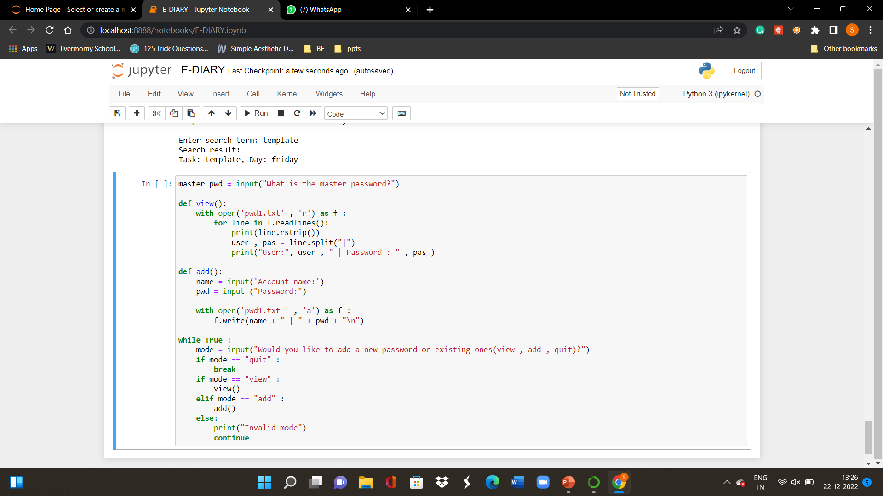
PASSWORD MANAGER
A string of characters that allows access to a computer system or service. Passwords provide the first line of defense against unauthorized access to your computer and personal information. The stronger your password, the more protected your computer will be from hackers and malicious software. •One doesn't need to have a good memory as everyone can incorporate the latest recommendations for secure passwords, including using long phrases, symbols, punctuation, and capitalization. •Passwords can be shared, guessed or stolen, which means they aren't secure

Slide 12
WHAT ALL IS USED IN THE
CODE (PASSWORD MANAGER)
A function is a block of code which only runs when it is called.
We can pass data known as parameters into a function
A function can return data as a result
A function is defined using def keyword
Example:
def my_function(): print("Hello using a function")
YOU WILL MISS THE BEST THINGS IF YOU KEEP YOUR EYES SHUT!!!!!
☺☺☺☺

Slide 13
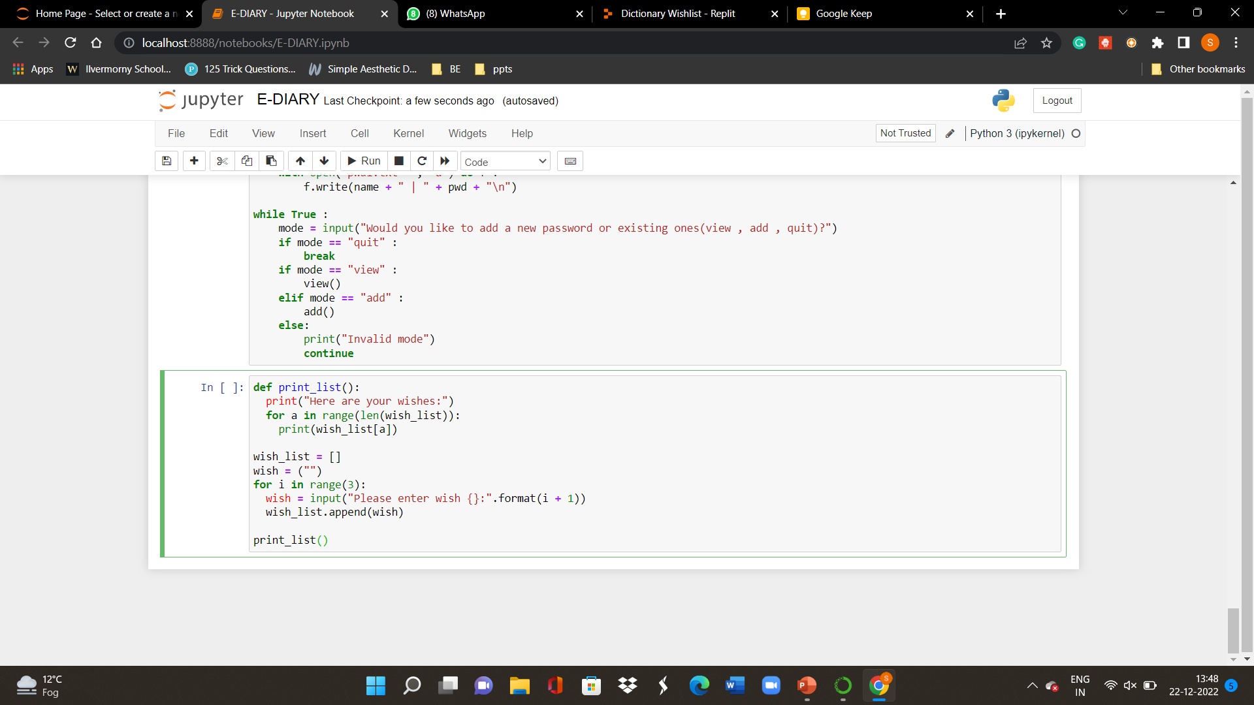
WISHLIST
A wishlist also known as "the bucket list" is a list of the experiences or achievements that a person hopes to have or accomplish during their lifetime. A bucket list is an itemized list of goals people want to accomplish before they “kick the bucket”. Adv: •Pushes the Boundaries Your Comfort Zone •Makes You Feel Accomplished •Keeps You Active •Creates Focus •When you rely on plans too much, you can end up losing the authenticity of your experiences. You won’t know everything there is to see and do in a destination before you visit it, and a bucket list can stop you from discovering that.

Slide 14
WHAT ALL IS USED IN THE
CODE (WISHLIST)
NESTED LOOPS
A nested loop is a loop inside a loop.
The "inner loop" will be executed one time for each iteration of the "outer loop"
adj =("red", "big", "tasty“) fruits =("apple", "banana", "cherry“)
for x in adj: for y in fruits: print(x, y)
GREAT THINGS ARE NOT DONE BY ONE PERSON.THEY’RE DONE BY A TEAM OF PEOPLE
☺☺☺☺

Slide 15

Presented by:
The Brainiacs ☺
Sanya Dilshad-792
Savya Sharma-809
Saniya Singla-789

